Slide 1

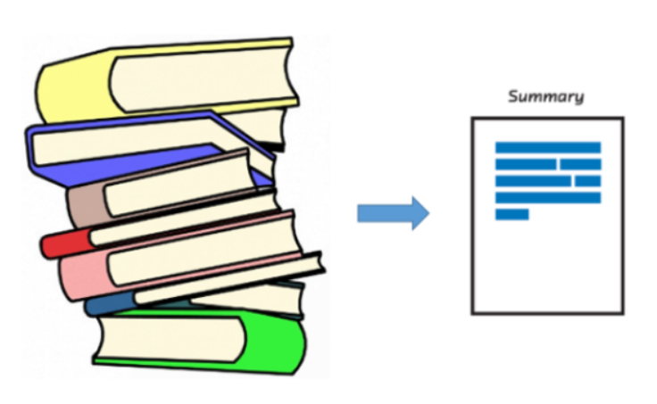
Text Summarization
PGP AIML Batch 2018-20
Team Members
Satvik Thakur
Ujjwal Tandon
Shubham Rohatagi
Gautam Gupta

Slide 2



Problem Definition
Business Problem
Importance
Value Addition
Propelled by the modern technological innovations, data is to this century what oil was to the previous one. Today, our world is parachuted by the gathering and dissemination of huge amounts of data
In fact, as per the International Data Corporation that the total amount of digital data circulating annually around the world would sprout to hit 180 zettabytes in 2025
There is a need to develop algorithm that can automatically shorten the huge amount of data circulating in the digital space without changing its original intent to reduce reading time and accelerate accessibility
There are live examples of implementation like News in Short, Blinkist etc. which use these algorithms to reduce human effort
The extracted summary could act as a baseline to refer and can be further refined with minimal human input as compared to the original effort
This would help accelerate things and enable us to digest huge volume of textual information in a more concise and quick manner

Slide 3


Type of summarization
Extractive Summarization
Select parts (typically sentences) of the original text to form a summary.
Abstractive Summarization
Generate novel sentences using natural language generation techniques.
Easier
Too restrictive (no paraphrasing)
Most past work is extractive
More difficult
More flexible and human
Necessary for future progress

Slide 4

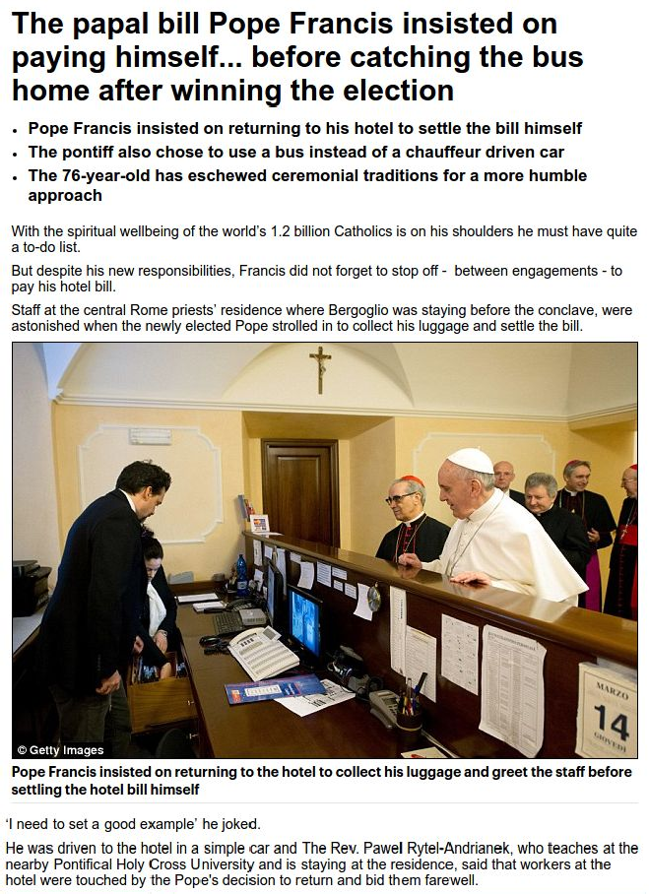

CNN Daily Mail dataset
Long news articles (average ~800 words)
Multi-sentence summaries (usually 3 or 4 sentences, average 56 words)
Summary contains information from throughout the article

Slide 5
Datasets Used
CNN
Questions: here
Stories: here
Raw HTML: here
This dataset contains the documents and accompanying questions from the news articles of CNN. There are approximately 90k documents and 380k questions. Available 'questions/', which should be sufficient to reproduce the setting from the original paper, and 'stories/', which can be useful for other uses of this dataset.
Daily Mail
Questions: here
Stories: here
Raw HTML: here
This dataset contains the documents and accompanying questions from the news articles of Daily Mail. There are approximately 197k documents and 879k questions. Available 'questions/', which should be sufficient to reproduce the setting from the original paper, and 'stories/', which can be useful for other uses of this dataset.

Slide 6
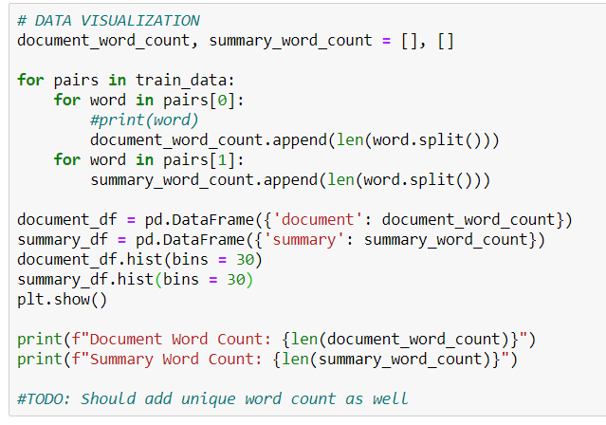
Exploratory Data Analysis
Code to calculate the distribution of word count per article and the corresponding summary

Slide 7
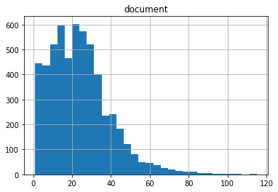
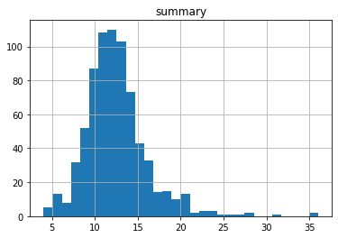
Exploratory Data Analysis
Graphs showing distribution of word count in document and summary for the sample considered
We observe that majority of the article contains words in the range of 400-500
# Words
# Documents
# Words
Summaries show a normalized trend with the mean around 100 words per summary
# Documents

Slide 8
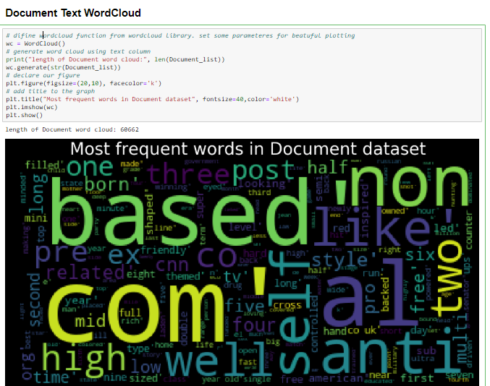
Exploratory Data Analysis

Slide 9
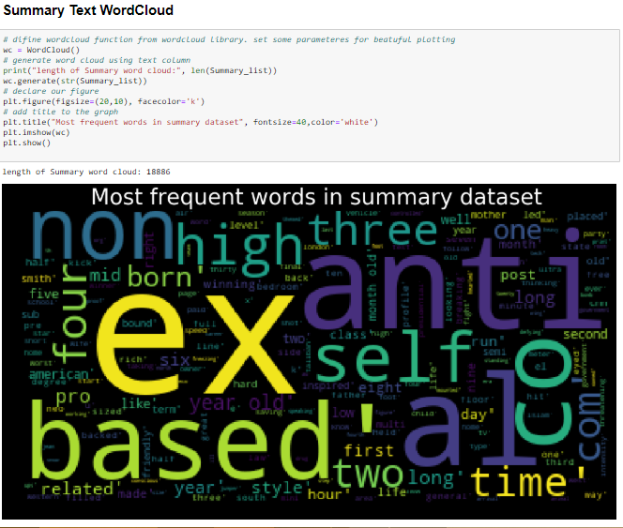
Exploratory Data Analysis

Slide 10
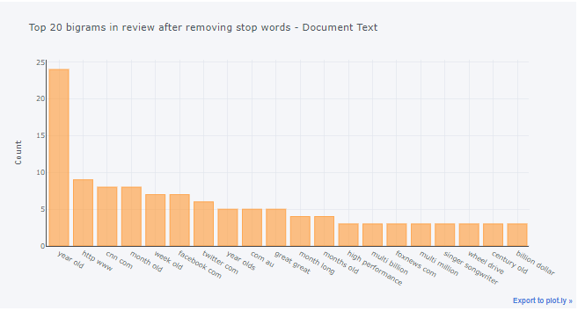
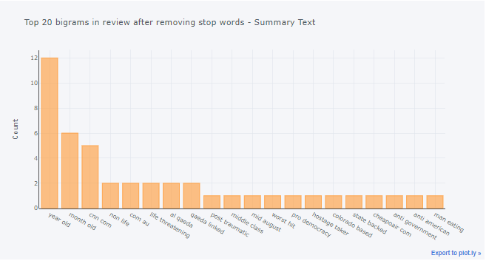
Exploratory Data Analysis
Graphs showing top bi-grams count distribution in document and summary text for the sample considered
Document
Summary

Slide 11
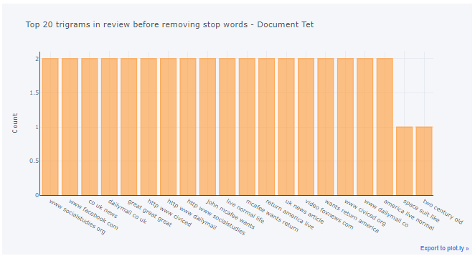
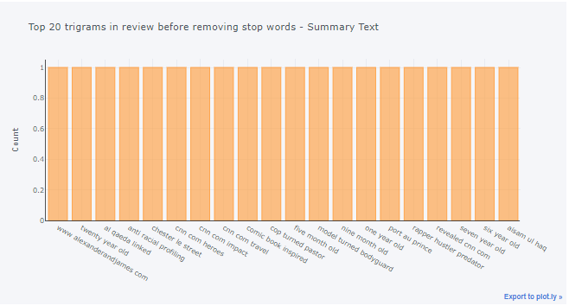
Exploratory Data Analysis
Graphs showing top tri-grams count distribution in document and summary text for the sample considered
Document
Summary

Slide 12

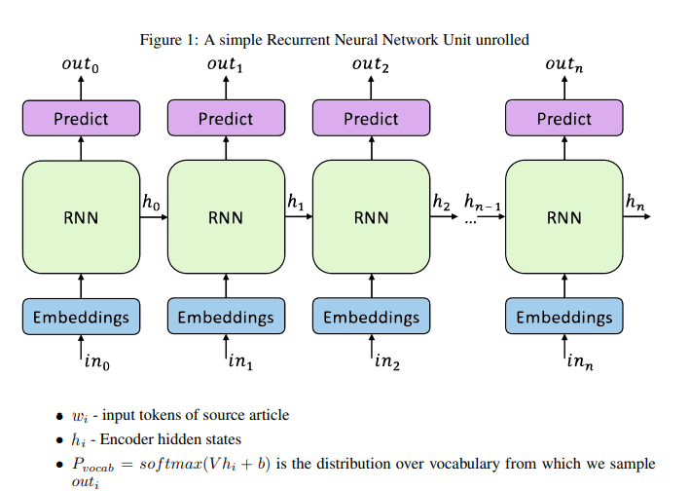
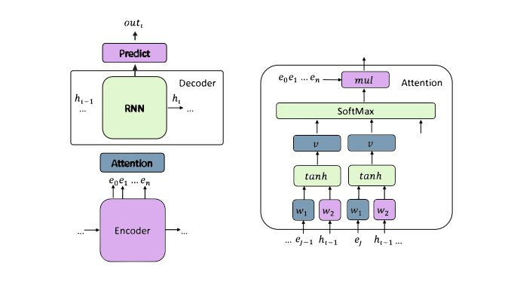
Baseline algorithm
Sequence to sequence model with attention
Recurrent neural network
Attention Mechanism
This method had some flaws mainly explained below:
Reproduce factual details inaccurately especially for OOV words
Summaries repeat themselves

Slide 13
Pointer Generator Network with coverage
Following algorithm was used to tackle the problems with baseline seq. to seq. attention model
Pointer Generator Network
This algorithm helps to solve the challenge of OOV words and factual errors.It works better for multi-sentence summaries. The basic idea is to choose between generating a word from the fixed vocabulary or copying one from the source document at each step of the generation. It brings in the power of extractive methods by pointing (Vinyals et al. [2015]). So for OOV words, simple generation would result in UNK, but here the network will copy the OOV from source text. At each step we calculate generation probability pgen = σ(w T h∗h ∗ t + w T s ht + w T x xt + bptr)
Coverage
The idea is that we use the attention distribution to keep track of what’s been covered so far, and penalize the network for attending to same parts again to

Slide 14




Pointer Generator Network - Framework
Final Distribution
"Argentina"
"2-0"
a
zoo
Vocabulary
Distribution
Context Vector
a
zoo
Attention Distribution
Decoder
Hidden States
Encoder
Hidden
States
...
Germany emerge victorious in
2-0 win against Argentina
Source Text
on Saturday ...
<START> Germany beat
Partial Summary

Slide 15

Model Evaluation – ROUGE Score
ROUGE stands for Recall-Oriented Understudy for Gist Evaluation. It essentially measures how much the words (and/or n-grams) in the human reference summaries appeared in the machine generated summaries.
ROUGE-N: Overlap of N-grams between the system and reference summaries.
ROUGE-1 refers to the overlap of 1-gram (each word) between the system and reference summaries
ROUGE-2 refers to the overlap of bigrams between the system and reference summaries
ROUGE-L: Longest Common Subsequence (LCS) based statistics. Longest common subsequence problem takes into account sentence level structure similarity naturally and identifies longest co-occurring in sequence n-grams automatically
ROUGE-W: Weighted LCS-based statistics that favors consecutive LCSes
ROUGE-S: Skip-bigram based co-occurrence statistics. Skip-bigram is any pair of words in their sentence order
ROUGE-SU: Skip-bigram plus unigram-based co-occurrence statistics

Slide 16

Model Scoring – Comparison with benchmark
CAPSTONE PROJECT RESULTS IN COMPARISON WITH BENCHMARK RESULTS PRODUCED BY STANDFORD PAPER ON POINTER GENERATOR NETWORKS
 | Without Coverage |  | With Coverage
Vocabulary Size |  | 50,000 |  | 50,000
Dataset |  | Validation |  | Validation
Mode |  | Decode |  | Decode
System specification |  | Linux Machine |  | Linux Machine
Training Time |  | 3 days 3 hrs |  | + 3 hrs 50 mins
Iterations |  | 47,128 |  | 50,064
Validation Time |  | 6-7 hrs |  | 6-7 hrs
Evaluation Metrics | Benchmark Abigail See : Stanford Univ | Pointer Generator with attention | Benchmark Abigail See : Stanford Univ | Pointer Generator with attention
Rouge 1 | F Score | 0.3644 | 0.36645 (+0.00205) | 0.3953 | 0.39412 (-0.00118)
Rouge 1 | Precision |  | 0.3598 |  | 0.38598
Rouge 1 | Recall |  | 0.40253 |  | 0.43650
Rouge 2 | F Score | 0.1566 | 0.15627 (-0.00033) | 0.1728 | 0.16967 (-0.00313)
Rouge 2 | Precision |  | 0.15397 |  | 0.16701
Rouge 2 | Recall |  | 0.17168 |  | 0.18746
Rouge L | F Score | 0.3342 | 0.33199 (-0.00221) | 0.3638 | 0.35890 (-0.0049)
Rouge L | Precision |  | 0.32614 |  | 0.35174
Rouge L | Recall |  | 0.36455 |  | 0.39724

Slide 17

Model Outcome
ARTICLE: a super slimmer who swelled to 26 stone after eating a loaf of bread a day is now toasting her diet - and literally becoming half the woman she used to be . michelle quinn , 42 , ballooned after munching her way through toast , _sarnies_ and slices of bread all day . her diet used to be made up of white toast with margarine for breakfast , sandwiches and crisps for lunch and fish and chips and takeaways for dinner . michelle quinn has lost half of her body weight after ditching her _bread-based_ diet which saw her eat a loaf a day , she has also dropped from a clothes size 30 -lrb- left -rrb- to a size 12 -lrb- right -rrb- . before losing weight 43-year-old michelle was a size 30 , here she proudly holds up a pair of her old trousers . but she gave up the bread and started a diet of breakfast of cereal or fruit and yoghurt , home-made soup for lunch and healthy versions of her favourite meals . michelle , of south shields , tyneside , says she feels like a new woman after losing 12.5 st and dropping from dress size 30 to size 12 . she has been named slimming world 's greatest loser in the west _harton_ area of south shields . she said : ' i feel like a new woman since losing weight . in fact , i look so different that people who i _havent_ seen for a while often ca n't believe i 'm the same person . ` for me though it 's the change on the inside that 's been the biggest - i 'm happier , healthier and much more confident now . michelle , pictured with her uncle derek , joined a slimming group in 2013 in a bid to shift the weight , she says she had struggled with high blood pressure , back pain and that she got breathless easily . michelle was not fat as a child but piled on the pounds thanks to her diet of fish and chips and _sandwhiches_ . now a size 12 , michelle no longer feels the need to eat a whole loaf of bread every day . she continued : ' i still enjoy all my favourite meals like burgers and chips and roast dinners but i 've learned how to make small changes like using lean meat or cooking with low calorie spray instead of oil or butter . ` it fits in really well with the rest of my family and we can all eat the same meals . ' michelle weighed _25st_ 3lbs when she joined the group in april 2013 and has since dropped to 12st 10lbs . she said : ` before i lost the weight i hid behind a big bubbly personality . i 'd pretend it did n't bother me that i was bigger than most other people , but that was far from the truth . ' i hated shopping for clothes and found just climbing up stairs and doing simple everyday tasks would leave me tired and out of breath . ' michelle 's weight was also putting a huge strain on her health and she suffered with high blood pressure , chronic back pain and got breathless easily.
Reference Text: michelle quinn ballooned thanks to her addiction to bread and chips . the 42-year-old would eat a whole loaf of bread a day . in 2013 she weighed more than !!_25st_!! and was a size 30 dress size . after joining a slimming group her weight has dropped to 12 stone 10lbs .
Decoded Text: michelle quinn , 42 , ballooned after munching her way through toast , sarnies and slices of bread all day . her diet used to be made up of white toast with margarine for breakfast , sandwiches and crisps for lunch and fish and chips for dinner . before losing weight 43-year-old michelle was a size 30 , here she proudly holds up a pair of her old trousers .
Original Story
Human-written summary
Model Generated Summary

Slide 18

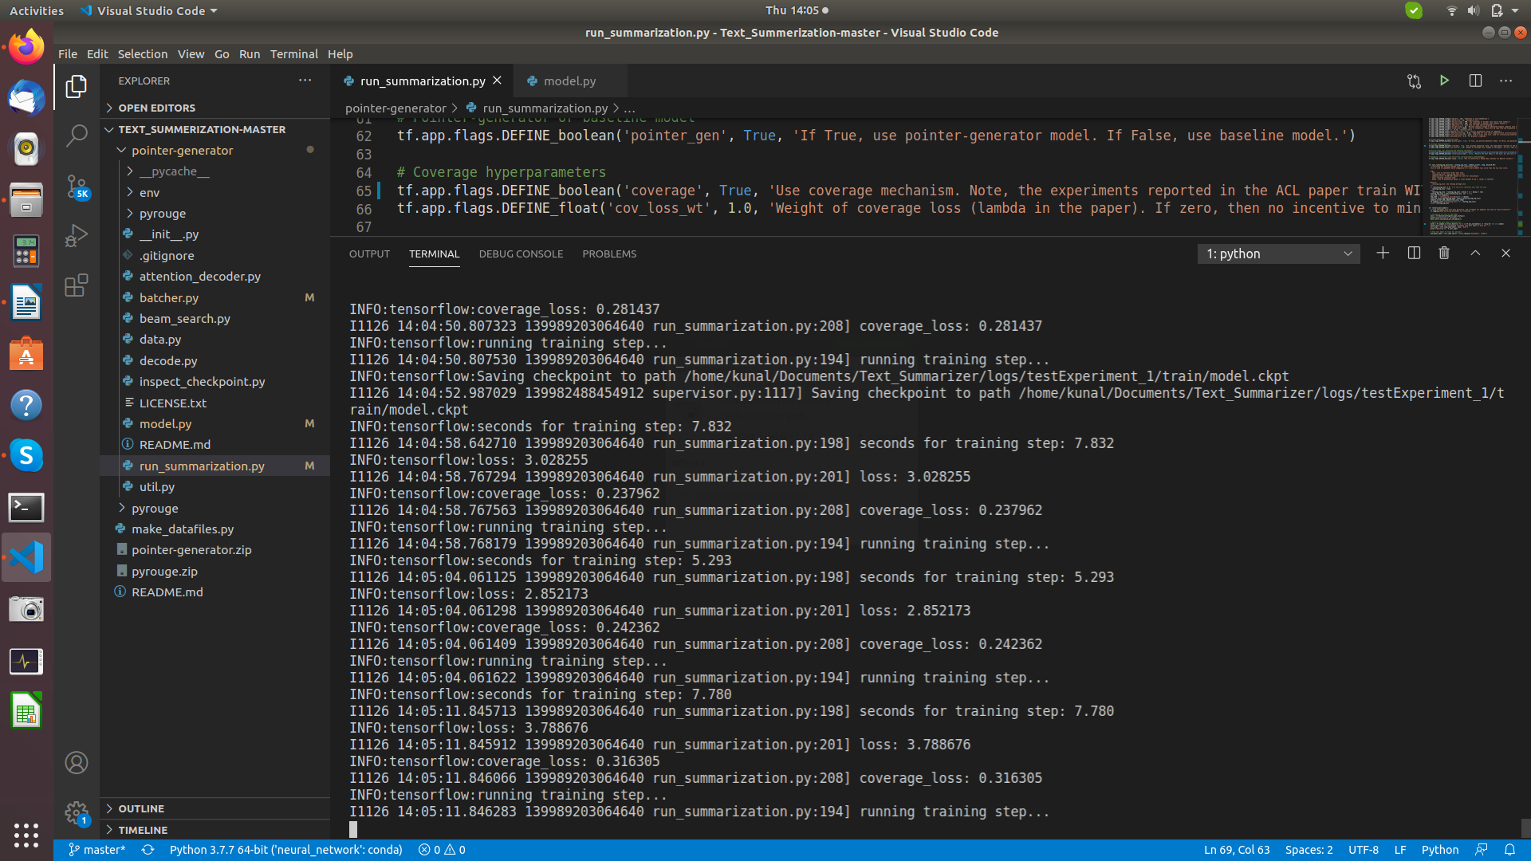
Model Training…..
Some snapshots

Slide 19
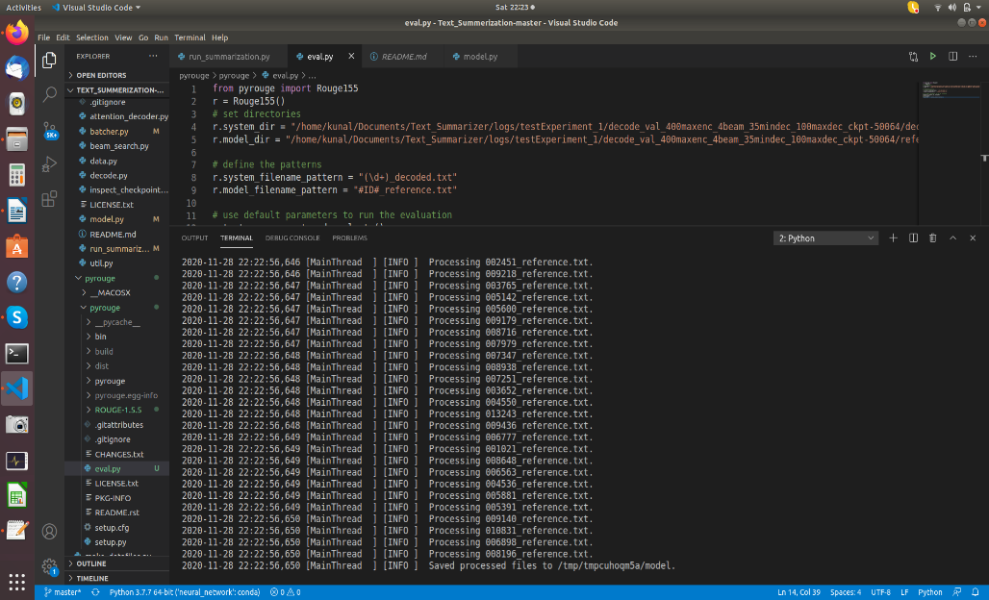
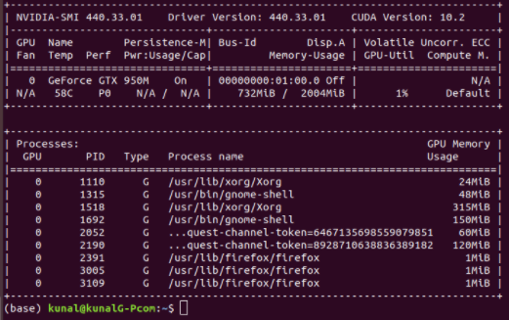
Model Training…..
Some snapshots

Slide 20
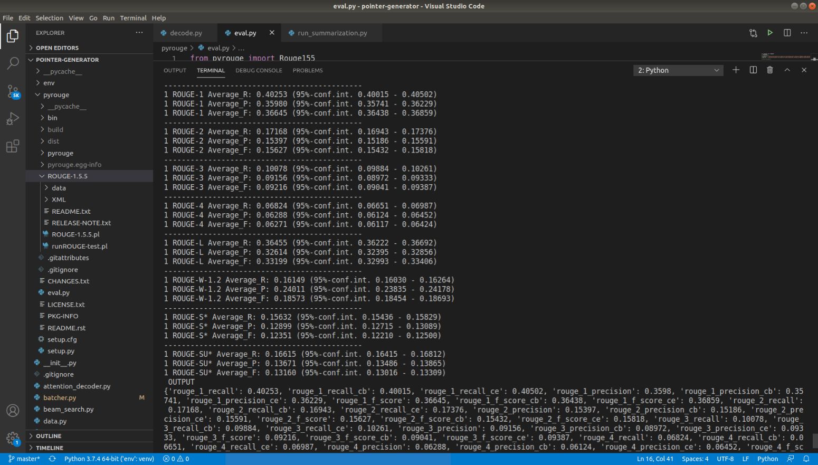
Model Training…..
Some snapshots

Slide 21

Infrastructure Used
Ran models using two different infra:
Local Linux System
RAM: 16 GB
GPU: GTX 950 (2 GB memory)
Processor: 4 CPUs
Tensorflow 1.14 is being used for our model
Cloud based EC2 instance (g3.4xlarge)
RAM: 122 GB
GPU: TESLA V100
Processor: 16 CPUs
Tensorflow 1.14 is being used for our model
Environmental set-up challenges:-
Difficult to setup CUDA on Windows machine
Pyrouge should be updated
Wordnet should be updated & aligned with Pyrouge

Slide 22

Challenges in summarization
Though the baseline gives decent results, they are clearly plagued by many problems
They sometimes tend to reproduce factually incorrect details
They struggle with Out of Vocabulary (OOV) words. So we see many UNK tokens in the summary
They are also a bit repetitive and focus on a word/phrase multiple time
Focus is mainly on single sentence summary tasks like headline generation
Problem with the metric ROUGE as a Metric is deficient.
With Pointer Generator Networks and Coverage Mechanism by Abigail See, it is possible to achieve a very high ROUGE score, without the summary being human readable. This clearly means that the way ROUGE measures summary is different from how humans evaluate a summary
Also it is rewarding for extractive strategies and is intolerant to ant rephrasing

Slide 23

Next Steps
Further work on fine tuning hyperparameters to enhance the model performance
Explore other advanced algorithms being used currently in summarization
Productionalize the model

Slide 24

Reference (1/2)
http://www.abigailsee.com/2017/04/16/taming-rnns-for-better-summarization.html
https://github.com/abisee/pointer-generator
https://machinelearningmastery.com/prepare-news-articles-text-summarization/
https://medium.com/@abhinaya08/data-scientists-guide-to-summarization-dde46b30b4c3
https://www.coursera.org/lecture/language-processing/get-to-the-point-summarization-with-pointer-generator-networks-RhxPO
https://stackoverflow.com/questions/38045290/text-summarization-evaluation-bleu-vs-rouge
https://towardsdatascience.com/illustrated-guide-to-lstms-and-gru-s-a-step-by-step-explanation-44e9eb85bf21
https://towardsdatascience.com/text-summarization-using-deep-learning-6e379ed2e89c
https://arxiv.org/pdf/1704.04368.pdf
https://en.wikipedia.org/wiki/ROUGE_(metric)
https://towardsdatascience.com/understanding-encoder-decoder-sequence-to-sequence-model-679e04af4346
http://www.abigailsee.com/2017/04/16/taming-rnns-for-better-summarization.html
https://arxiv.org/pdf/1707.02268.pdf
https://medium.com/mlreview/understanding-lstm-and-its-diagrams-37e2f46f1714
https://towardsdatascience.com/evaluating-text-output-in-nlp-bleu-at-your-own-risk-e8609665a213
https://arxiv.org/pdf/1707.02268.pdf
https://www.sciencedirect.com/science/article/abs/pii/S0306457318306241
https://github.com/abisee/cnn-dailymail
https://github.com/JafferWilson/Process-Data-of-CNN-DailyMail
https://medium.com/giscle/setting-up-a-google-cloud-instance-for-deep-learning-d182256cb894

Slide 25
Reference (2/2)
http://kavita-ganesan.com/what-is-rouge-and-how-it-works-for-evaluation-of-summaries/#.W5LhLJNKidt/
https://www.microsoft.com/en-us/research/wp-content/uploads/2016/07/was2004.pdf
https://journals.plos.org/plosone/article?id=10.1371/journal.pone.0115671
https://www.researchgate.net/publication/220106310_Evaluation_Measures_for_Text_Summarization
https://www.researchgate.net/publication/231901086_SUMMAC_a_text_summarization_evaluation
https://www.aclweb.org/anthology/D19-1051.pdf
https://arxiv.org/ftp/arxiv/papers/1210/1210.4871.pdf
https://www.researchgate.net/publication/338521721_Text_Summarization_Method_based_on_Double_Attention_Pointer_Network
https://github.com/kenlimmj/rouge
http://home.iitk.ac.in/~soumye/cs498a/report.pdf
https://www.tensorflow.org/datasets/catalog/cnn_dailymail
https://ieeexplore.ieee.org/document/7764406
https://www.mdpi.com/2078-2489/11/2/78/htm
https://www.cis.upenn.edu/~nenkova/papers/sumEval.pdf
http://www.cai.sk/ojs/index.php/cai/article/viewFile/37/24
https://www.technoarete.org/common_abstract/pdf/IJERCSE/v5/i4/Ext_04981.pdf

Slide 26
Thank You!

